Slide 1
13강.Actor-Critic: DDPG,SAC

Slide 2
Contents
Deep Deterministic Policy Gradient(DDPG)
Code Ex.1
Soft Actor Critic(SAC)
Code Ex.2

Slide 3
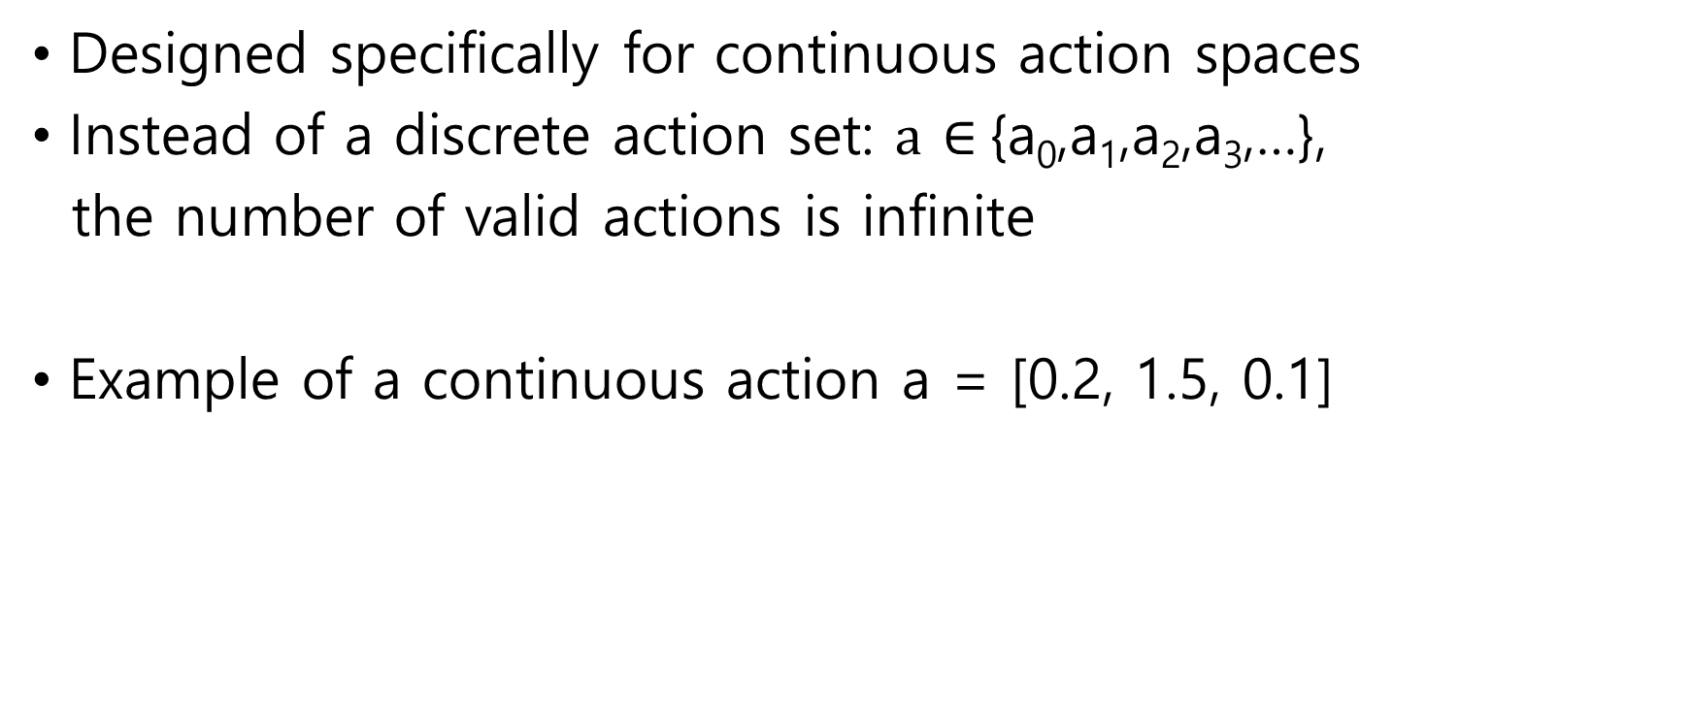
DDPG
Designed specifically for continuous action spaces
Instead of a discrete action set: $a$ $∈${a₀,a₁,a₂,a₃,…},
the number of valid actions is infinite
Example of a continuous action a = [0.2, 1.5, 0.1]

Slide 4
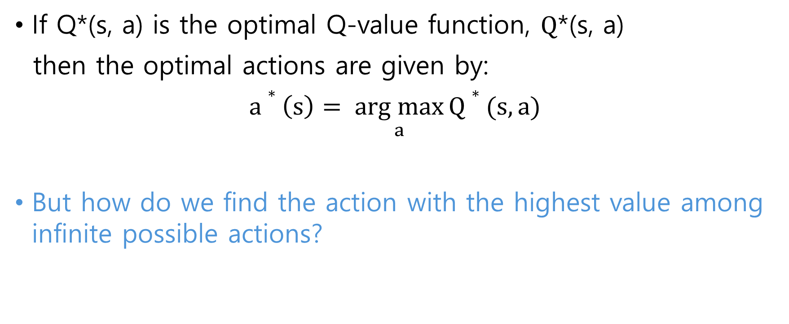
DDPG
If Q*(s, a) is the optimal Q-value function, $Q$*(s, a)
then the optimal actions are given by:
$a∗\left(s\right)= \underset{a}{arg max}{Q∗(s, a)}$
But how do we find the action with the highest value among infinite possible actions?

Slide 5
DDPG
In order to solve control tasks,
DDPG assume that Q(s, a(s)), is differentiable w.r.t a(s)
Q(s, a(s)) change very smoothly as the values of actions change
gradient ascent to get max. Q
Similar actions should have similar values:
E.g., action [1, -1], action[1.0001, -1] will have very similar Q values.
E.g., In practice, setting steering boat wheel at 15 is very similar to the setting 15.01

Slide 6
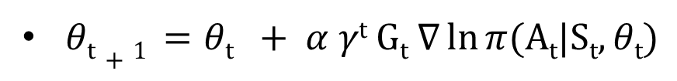
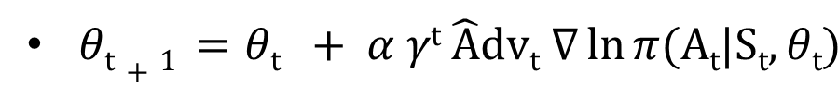
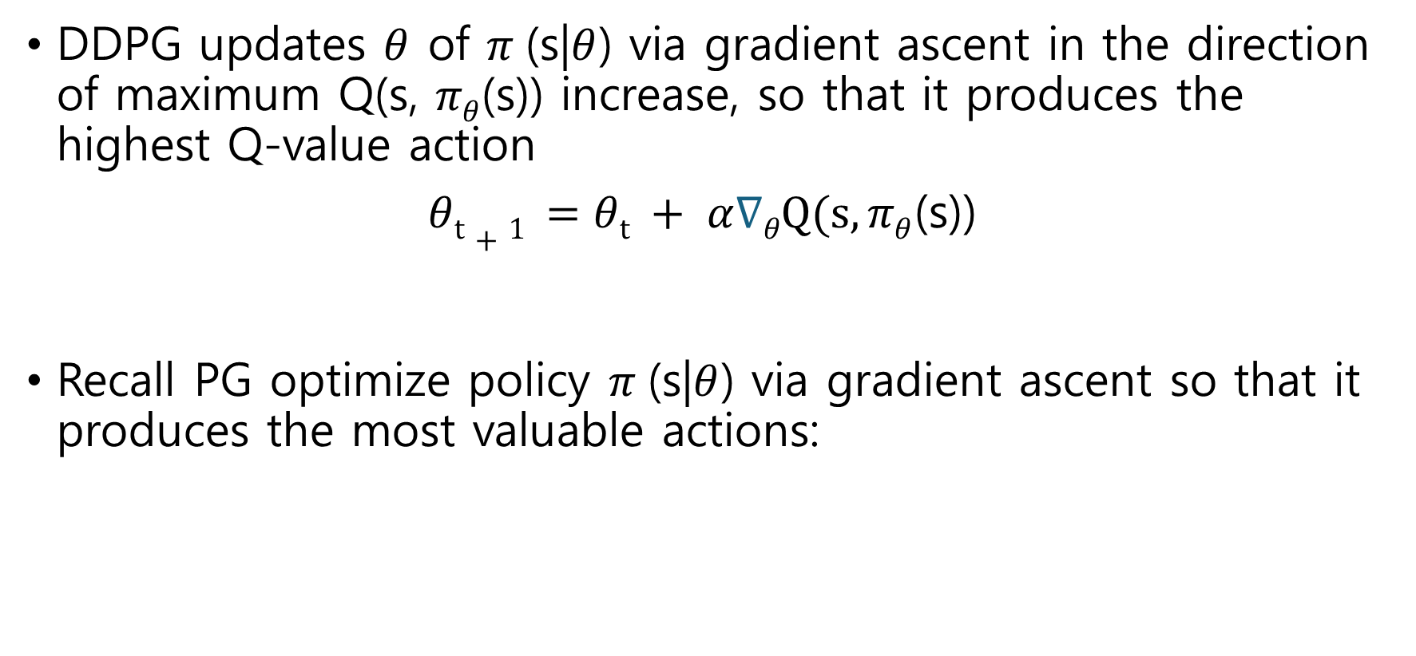
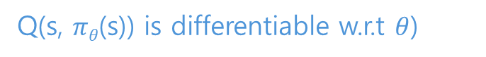
DDPG
DDPG updates $θ$ of $π$(s|$θ$) via gradient ascent in the direction of maximum Q(s, $πθ$(s)) increase, so that it produces the highest Q-value action
$θt+1 =θt + α∇θQ(s,πθ$(s))
Recall PG optimize policy $π$(s|$θ$) via gradient ascent so that it produces the most valuable actions:
Q(s, $πθ$(s)) is differentiable w.r.t $θ$)
REINFORCE
A2C

Slide 7
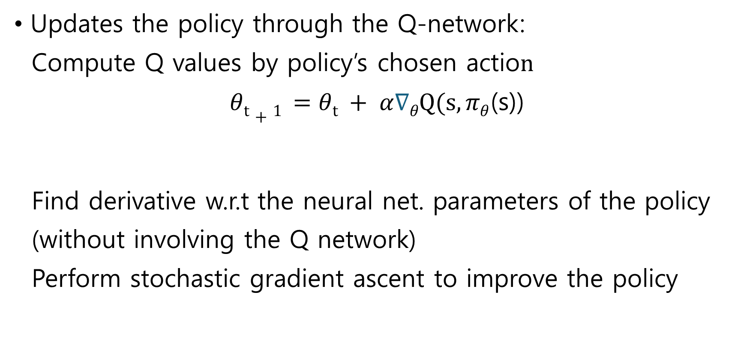
DDPG
Updates the policy through the Q-network:
Compute Q values by policy’s chosen actio$n$
$θt+1 =θt + α∇θQ(s,πθ$(s))
Find derivative w.r.t the neural net. parameters of the policy
(without involving the Q network)
Perform stochastic gradient ascent to improve the policy
Deterministic policy
(argmax policy)

Slide 8
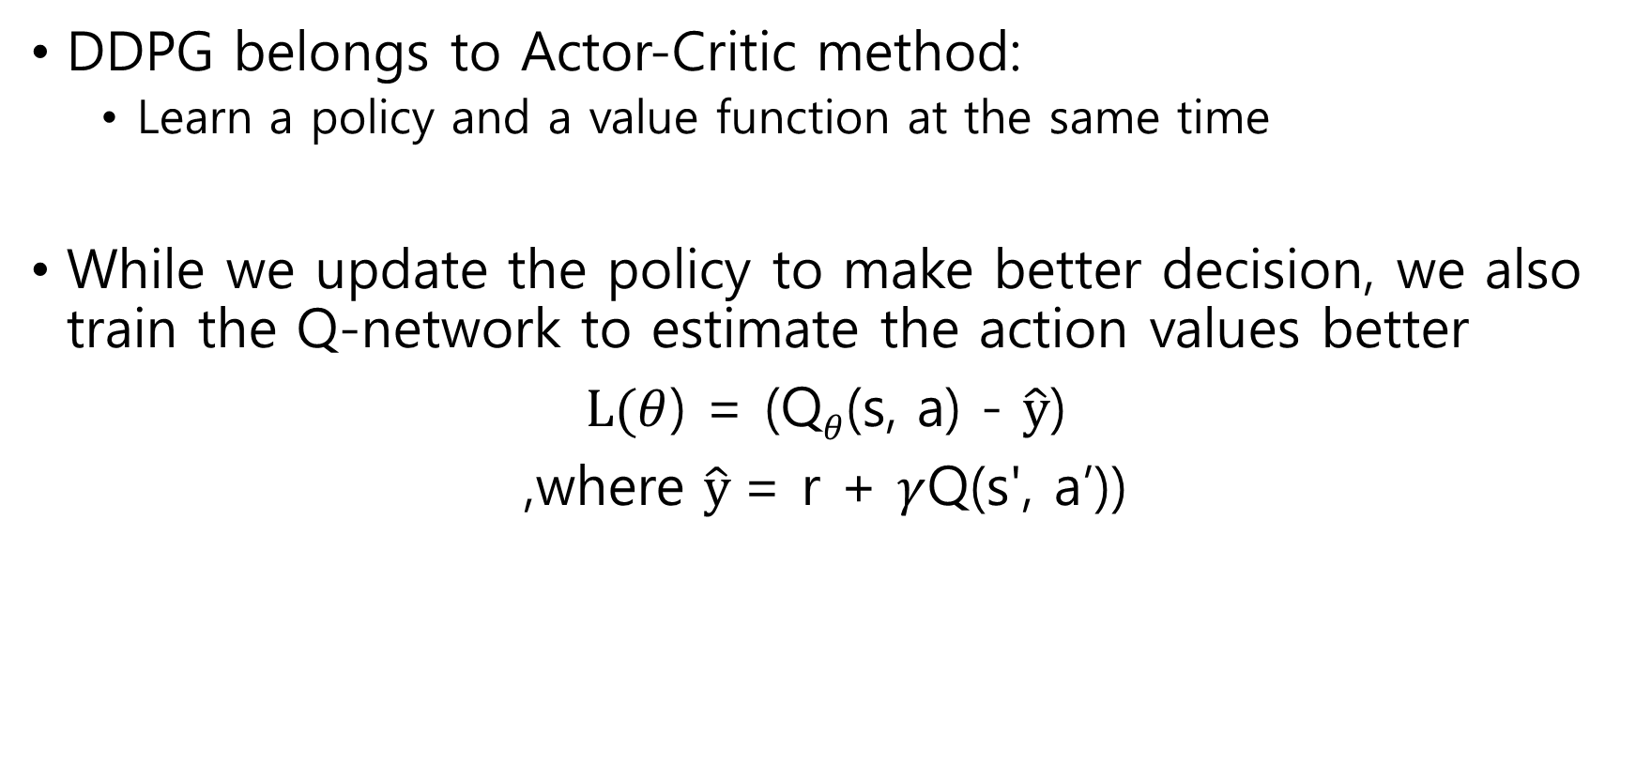
DDPG
DDPG belongs to Actor-Critic method:
Learn a policy and a value function at the same time
While we update the policy to make better decision, we also train the Q-network to estimate the action values better
$L(θ$) = (Q$θ$(s, a) - $\hat{y}$)
,where $\hat{y}$= r + $γ$Q(s', a’))

Slide 9
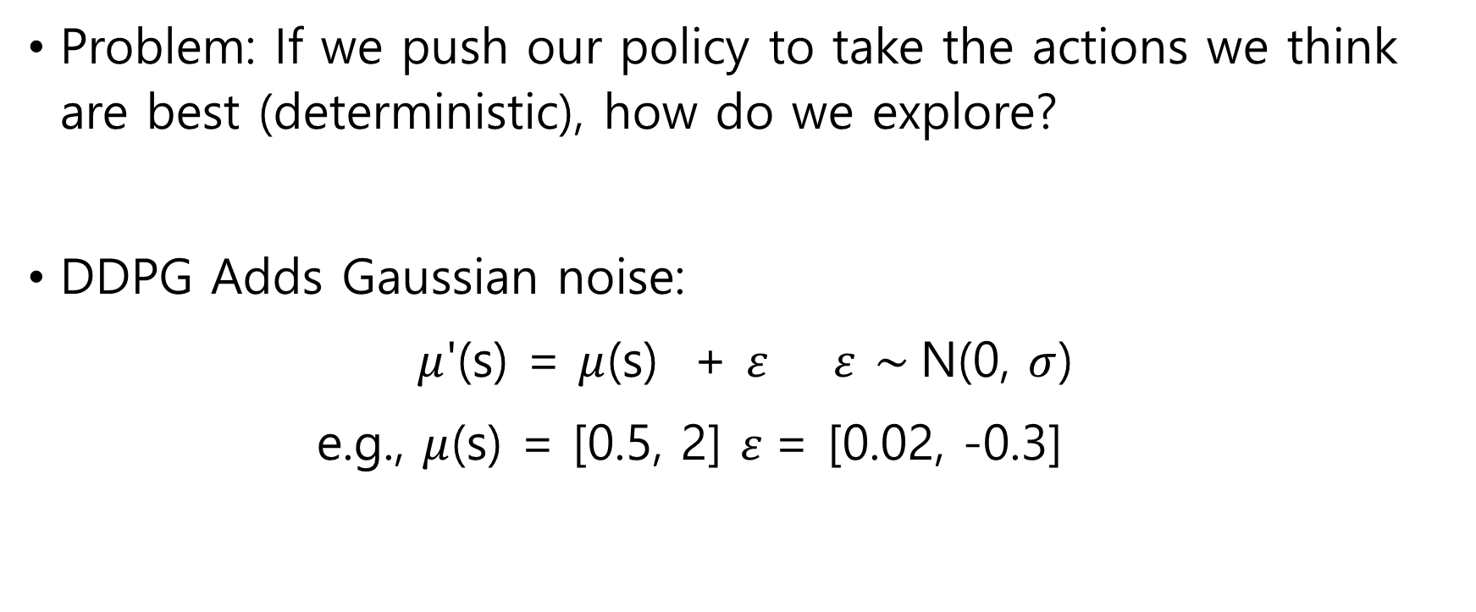
DDPG
Problem: If we push our policy to take the actions we think are best (deterministic), how do we explore?
DDPG Adds Gaussian noise:
$μ$'(s) = $μ$(s) + $ε$ $ε$ $\sim$N(0, $σ$)
e.g., $μ$(s) = [0.5, 2] $ε$= [0.02, -0.3]

Slide 10
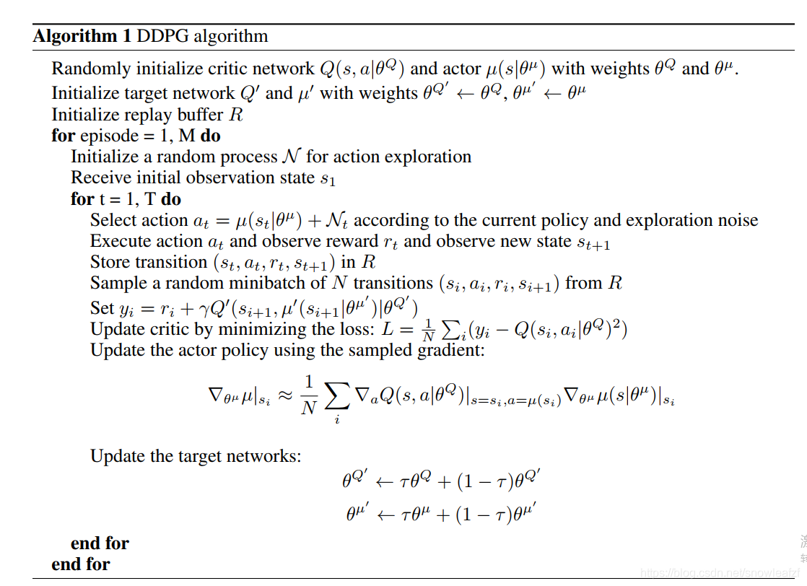
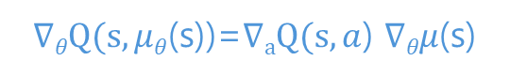
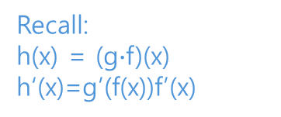
DDPG
Behavior policy is stochastic due to the added Gaussian noise for exploration
Target policy, Q net..
Target policy is deterministic
(a_{t+1} = argmax policy)
$∇θQ(s,μθ$(s))=$∇aQ(s,a$) $∇θμ$(s)
Recall:
h(x) = (g$∙$f)(x)
h‘(x)=g’(f(x))f’(x)

Slide 11
Let’s play with the code
Install Anaconda
Make a virtual environment:
conda create –n ‘your_name’ python=3.8
Pytorch Install:
go https://pytorch.kr/get-started/locally/ , and copy the command line depending on your computer OS
Gym Package Install:
pip install gym<0.25.0
pip install gym[box2d]
Pip install numpy==1.23.1
Pip install matplotlib

Slide 12
Let’s play with the code
In /DDPG
main_ddpg.py # main loop interacting the env., agent learning
ddpg_torch.py # defines agent obj.
networks.py # defines actor and critic network
buffer.py # defines replay buffer
noise.py # generates OU action noise
utils.py # plotting function
/temp # store parameters
/plots # store the score that agent get while training

Slide 13
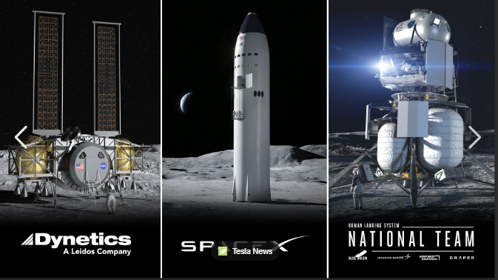
Let’s play with the code

Slide 14
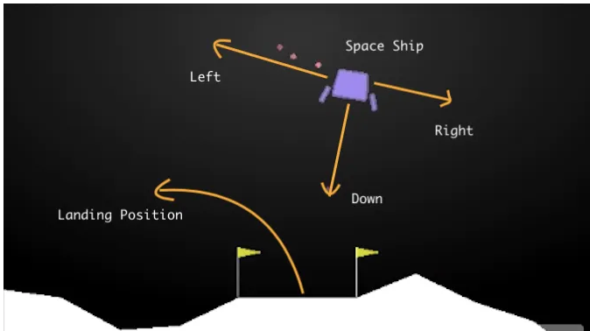
Let’s play with the code
LunarLanderContinuous-v2

Slide 15
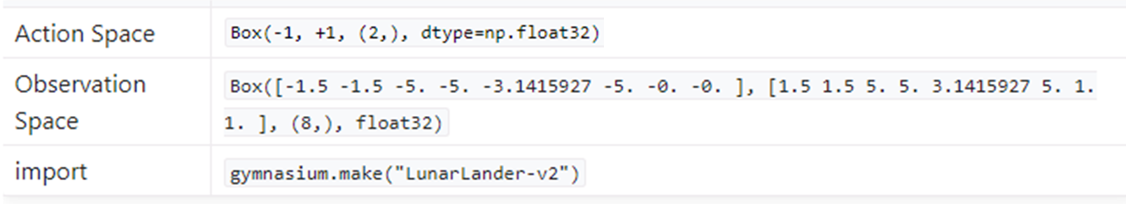
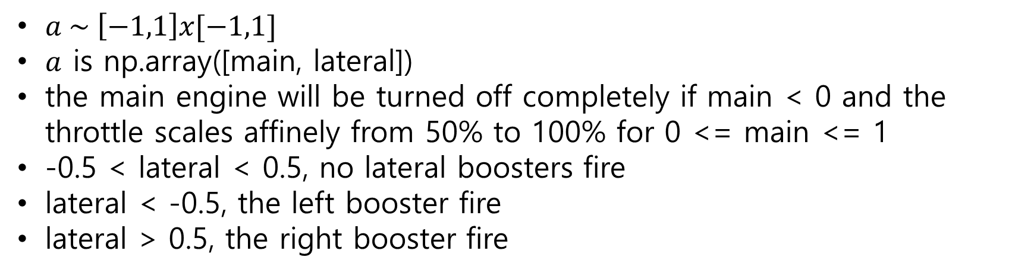
Let’s play with the code
$a \sim \left[−1,1\right]x[−1,1]$
$a$ is np.array([main, lateral])
the main engine will be turned off completely if main < 0 and the throttle scales affinely from 50% to 100% for 0 <= main <= 1
-0.5 < lateral < 0.5, no lateral boosters fire
lateral < -0.5, the left booster fire
lateral > 0.5, the right booster fire

Slide 16
11강.Soft Actor-Critic(SAC)

Slide 17
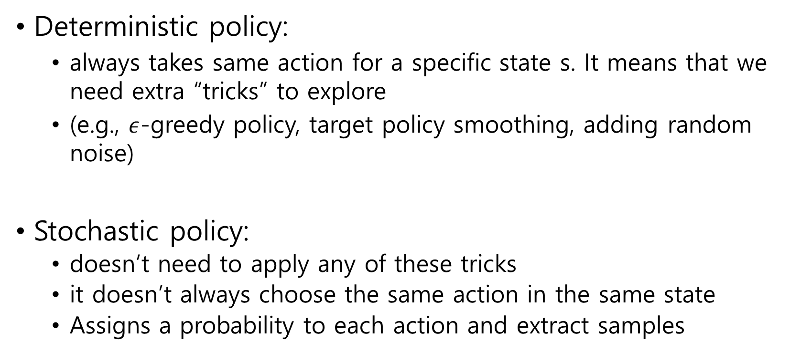
Problem with Deterministic Policy
Deterministic policy:
always takes same action for a specific state s. It means that we need extra “tricks” to explore
(e.g., $ε$-greedy policy, target policy smoothing, adding random noise)
Stochastic policy:
doesn’t need to apply any of these tricks
it doesn’t always choose the same action in the same state
Assigns a probability to each action and extract samples

Slide 18
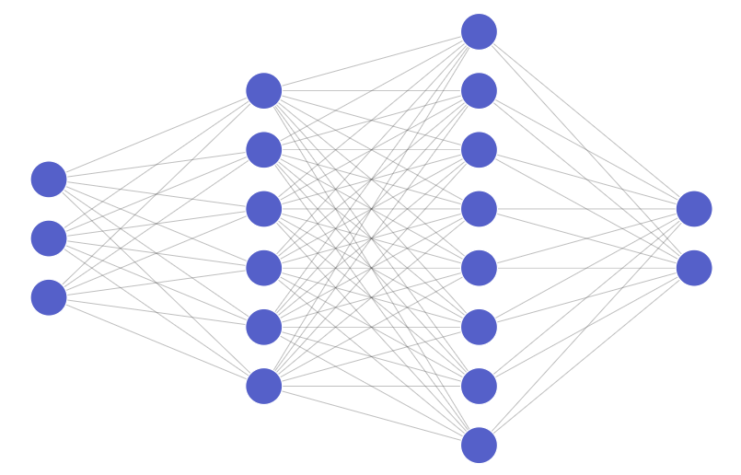
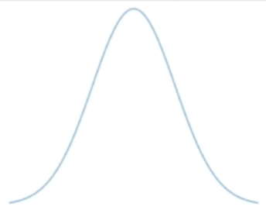
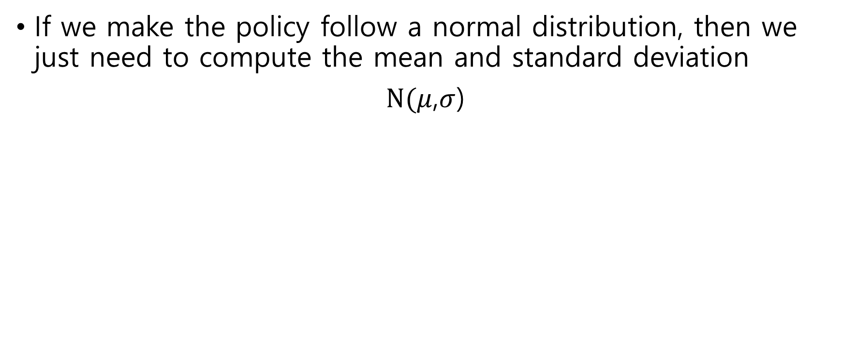


Stochastic policies
If we make the policy follow a normal distribution, then we just need to compute the mean and standard deviation
$N(μ$,$σ$)
Stochastic
policy
$$μ$$
$$σ$$
P(a | s)
s

Slide 19
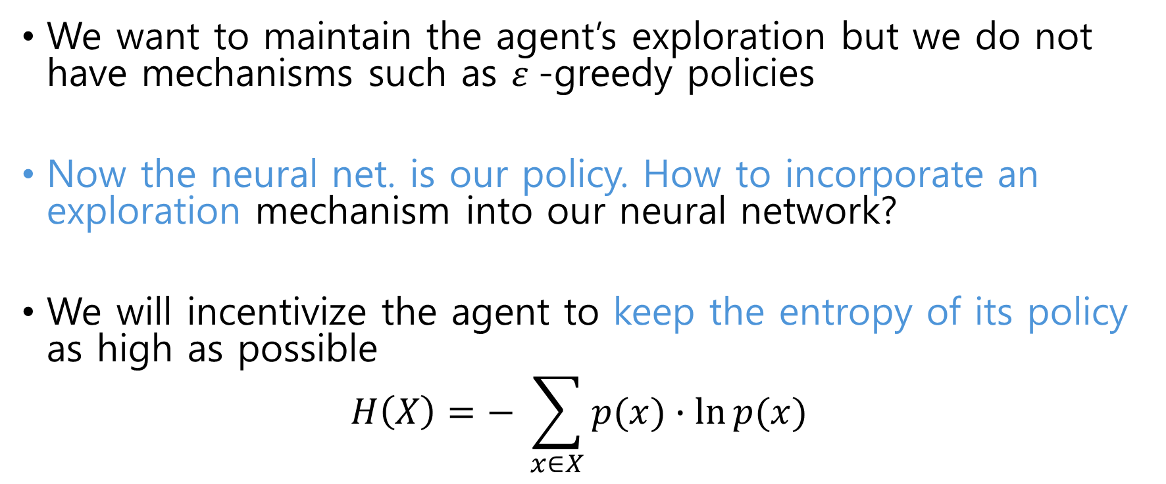
Entropy
We want to maintain the agent’s exploration but we do not have mechanisms such as $ε$-greedy policies
Now the neural net. is our policy. How to incorporate an exploration mechanism into our neural network?
We will incentivize the agent to keep the entropy of its policy as high as possible
$$H\left(X\right)=− \sum_{x∈X}{p(x)∙\ln{p(x)}}$$

Slide 20
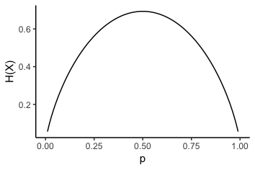
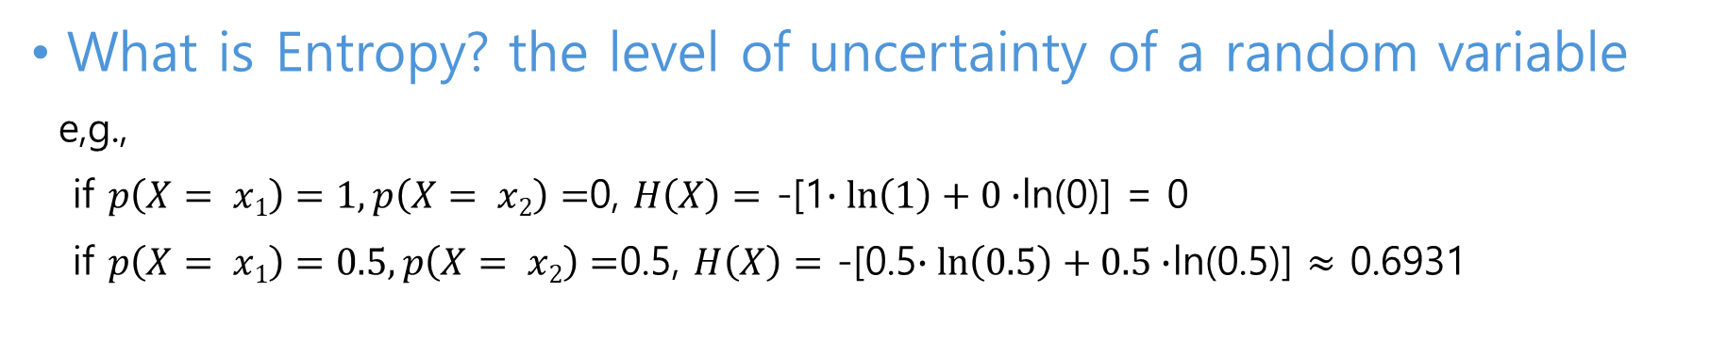
Entropy
What is Entropy? the level of uncertainty of a random variable
e,g.,
if $p\left(X= x1\right)=1,p\left(X= x2\right)=$0, $H\left(X\right)=$ -[1$∙\ln\left(1\right)+0∙$ln(0)] = 0
if $p\left(X= x1\right)=0.5,p\left(X= x2\right)=$0.5, $H\left(X\right)=$ -[0.5$∙\ln\left(0.5\right)+0.5∙$ln(0.5)] $≈$ 0.6931
Max. point where our confidence in our predictions will go down.
Max. point where it surprises us

Slide 21
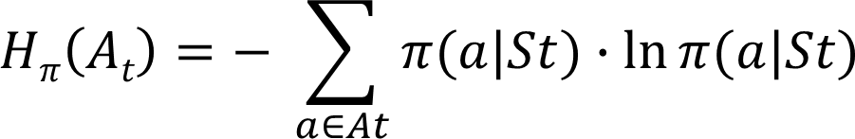
Entropy
What is the entropy of a policy?
Uncertainty in the action to be selected in a state:
Random variable(A_{t}) is the action the policy will choose in a state.
The entropy is computed by multiplying the probability of choosing each action by its logarithm and adding up the results

Slide 22
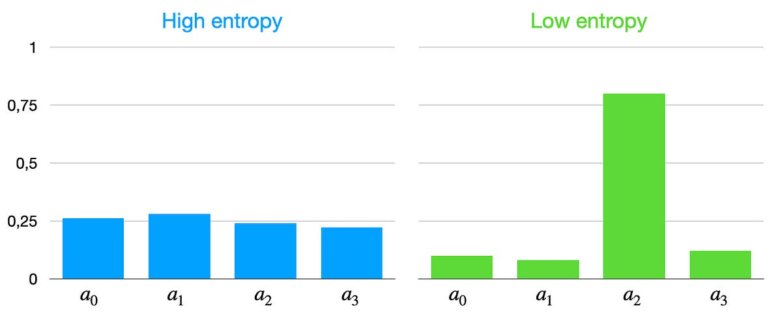
Entropy
What is the entropy of a policy?
Imagine that we have 4 actions available

Slide 23
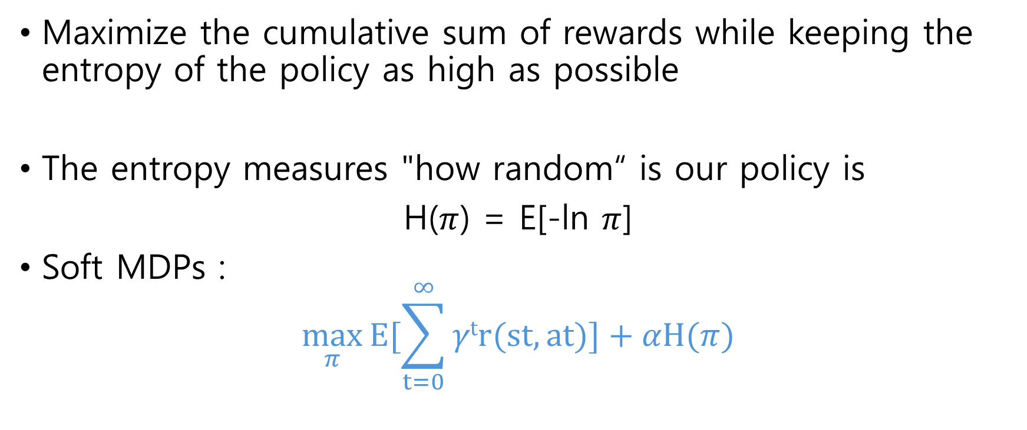
Entropy-regularized RL
Maximize the cumulative sum of rewards while keeping the entropy of the policy as high as possible
The entropy measures "how random“ is our policy is
H($π$) = E[-ln $π$]
Soft MDPs :
$$\max_{π}{E[\sum_{t=0}^{∞}{γtr(st,at)}]+αH(π)}$$
Entropy Regularization:
Entropy of policy distribution

Slide 24
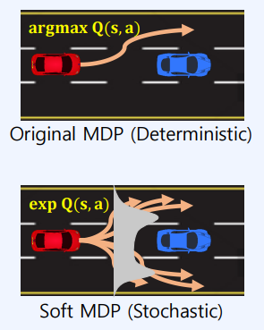
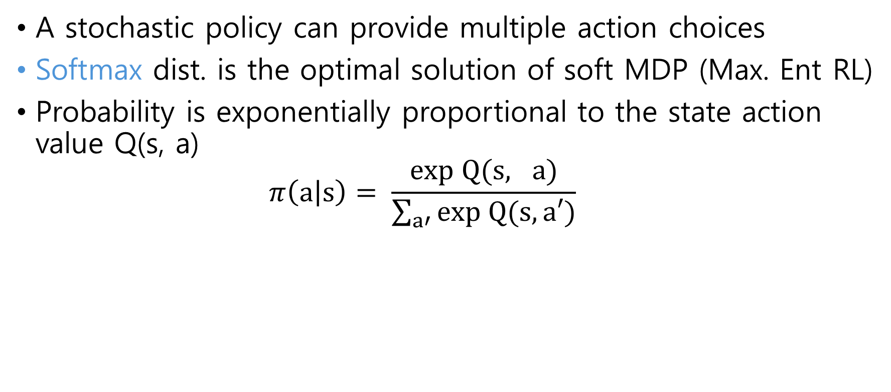
Softmax Policy
A stochastic policy can provide multiple action choices
Softmax dist. is the optimal solution of soft MDP (Max. Ent RL)
Probability is exponentially proportional to the state action value Q(s, a)
$$π\left(a | s\right)= \frac{exp Q(s, a)}{\sum_{a′}{exp Q(s, a′)}}$$

Slide 25
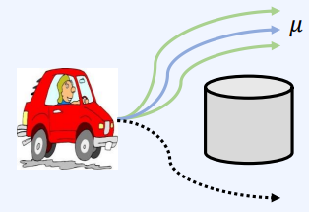
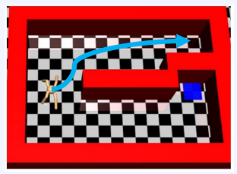
Softmax Policy
Robustness
By finding multiple near optimal actions
Avoid mode collapsing
Efficient exploration
Policy represents multiple promising actions till the end of learning
Escape from local optima

Slide 26
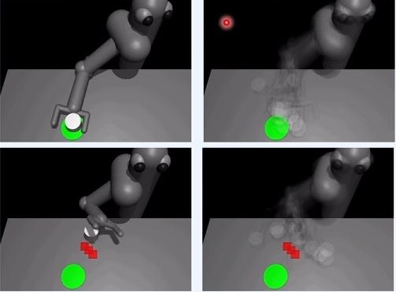
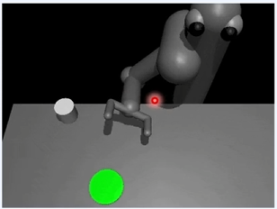
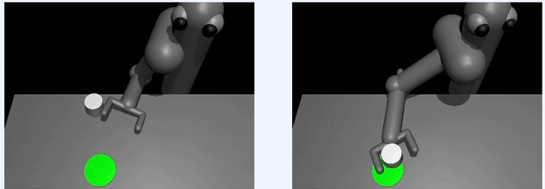
Softmax Policy
Std. RL vs. Max. Ent. RL
Std. RL vs. Max. Ent. RL

Slide 27
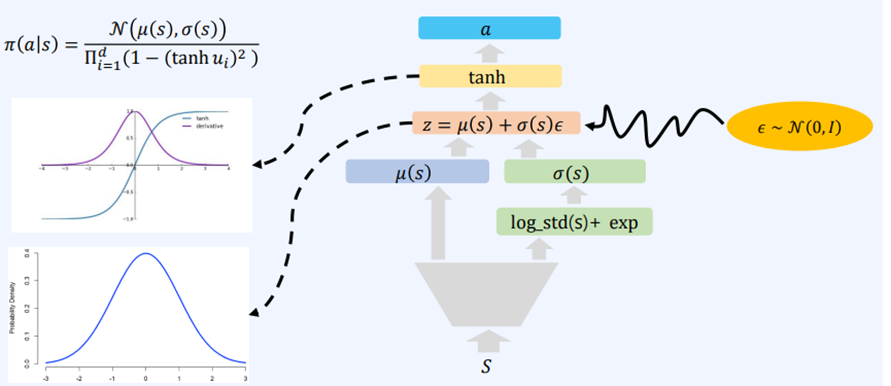
Soft Actor

Slide 28
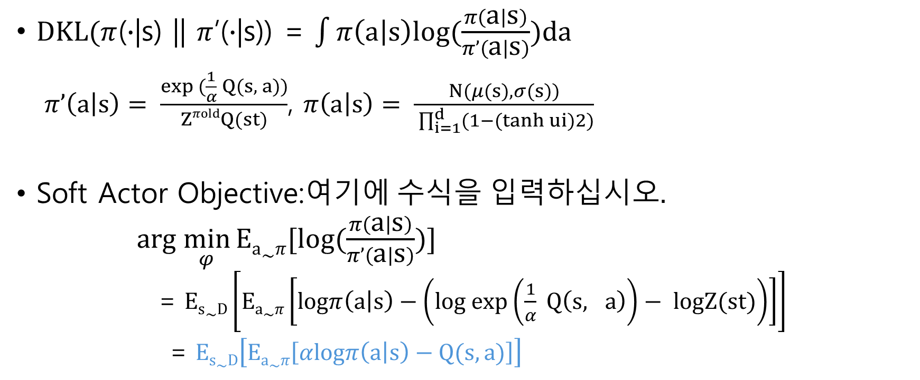
Soft Actor
$DKL(π$($∙$|s) || $π$’($∙$|s)) = $\int{π\left(a | s\right)log(\frac{π\left(a | s\right)}{π’\left(a | s\right)})da}$
$π’\left(a | s\right)= \frac{exp (\frac{1}{α} Q(s, a))}{ZπoldQ(st)}$, $π\left(a | s\right)= \frac{N(μ(s), σ(s))}{ \prod_{i=1}^{d}{(1−(tanh ui)2)}}$
Soft Actor Objective:
$arg \min_{φ}{Ea\sim π[log(\frac{π\left(a | s\right)}{π’\left(a | s\right)})]}$
= $Es\sim D\left[Ea\sim π\left[logπ\left(a | s\right)−\left(log exp\left(\frac{1}{α} Q\left(s, a\right)\right)− logZ(st)\right)\right]\right]$
= $Es\sim D\left[Ea\sim π\left[αlogπ\left(a | s\right)−Q(s, a)\right]\right]$
Can be ignored with no impact on the policy parameter differentiation
decreasing $logπ\left(a | s\right)$ = increasing entropy(–$logπ\left(a | s\right)$)

Slide 29
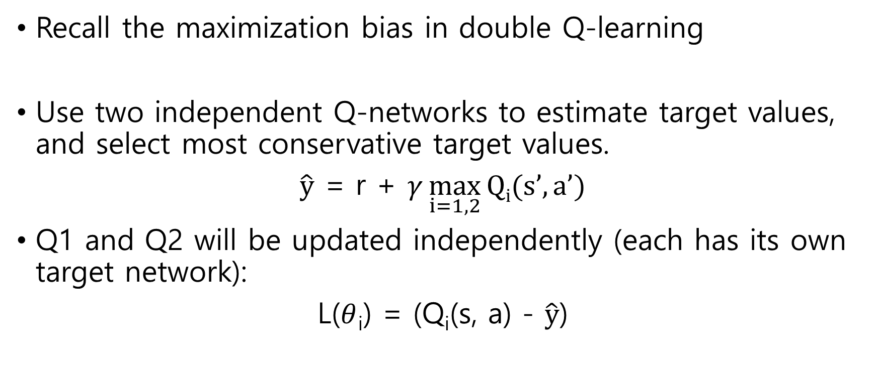
Double Q trick
Recall the maximization bias in double Q-learning
Use two independent Q-networks to estimate target values, and select most conservative target values.
$\hat{y}$ = r + $γ\max_{i=1,2}{Qi(s’,a’)}$
Q1 and Q2 will be updated independently (each has its own target network):
L($θ$_{i}) = (Q_{i}(s, a) - $\hat{y}$)

Slide 30
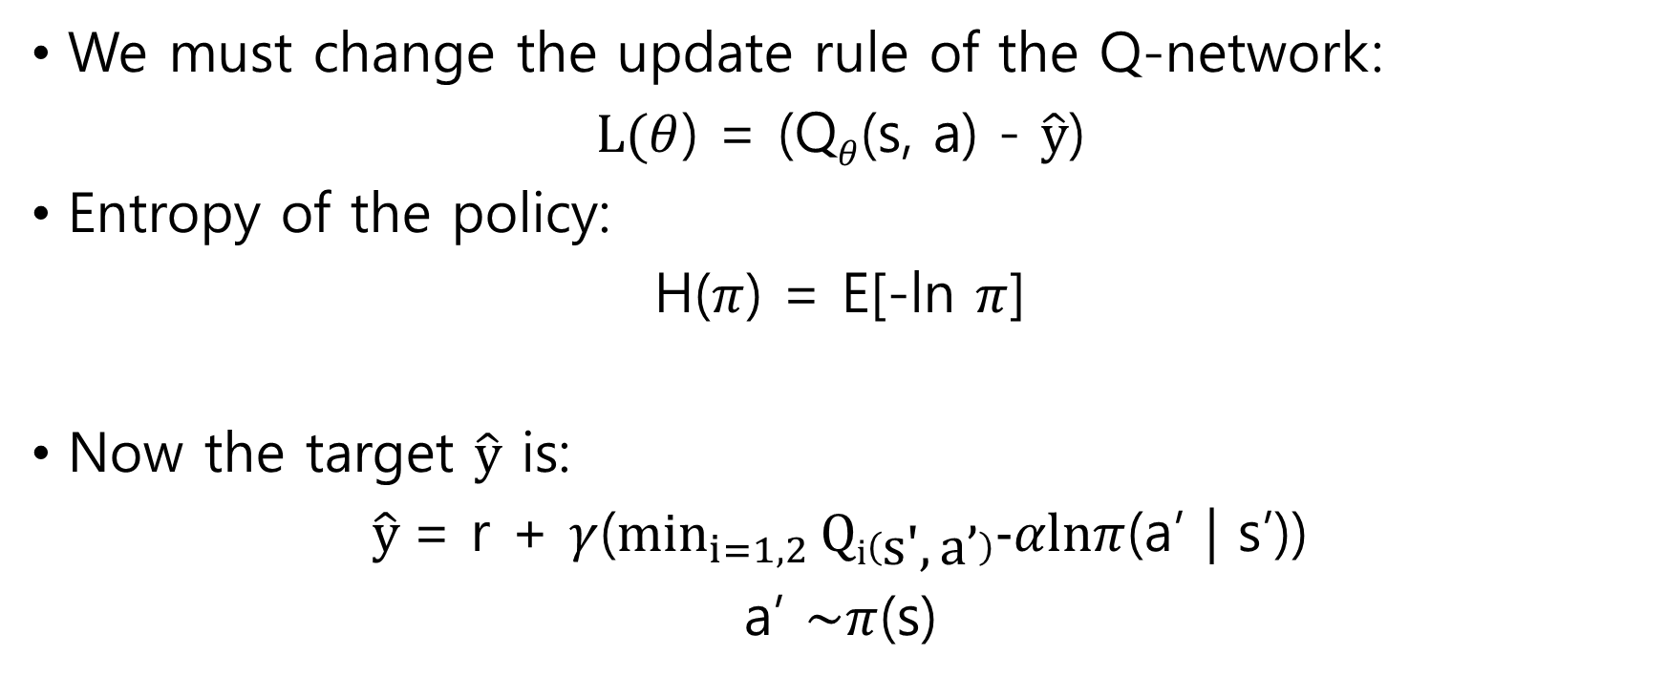
Double Q trick
We must change the update rule of the Q-network:
$L(θ$) = (Q$θ$(s, a) - $\hat{y}$)
Entropy of the policy:
H($π$) = E[-ln $π$]
Now the target $\hat{y}$ is:
$\hat{y}$= r + $γ$($\min_{i=1,2}{Qi\left(s′,a’\right)−αlnπ}$(a’ | s’))
a’ $\sim π$(s)

Slide 31
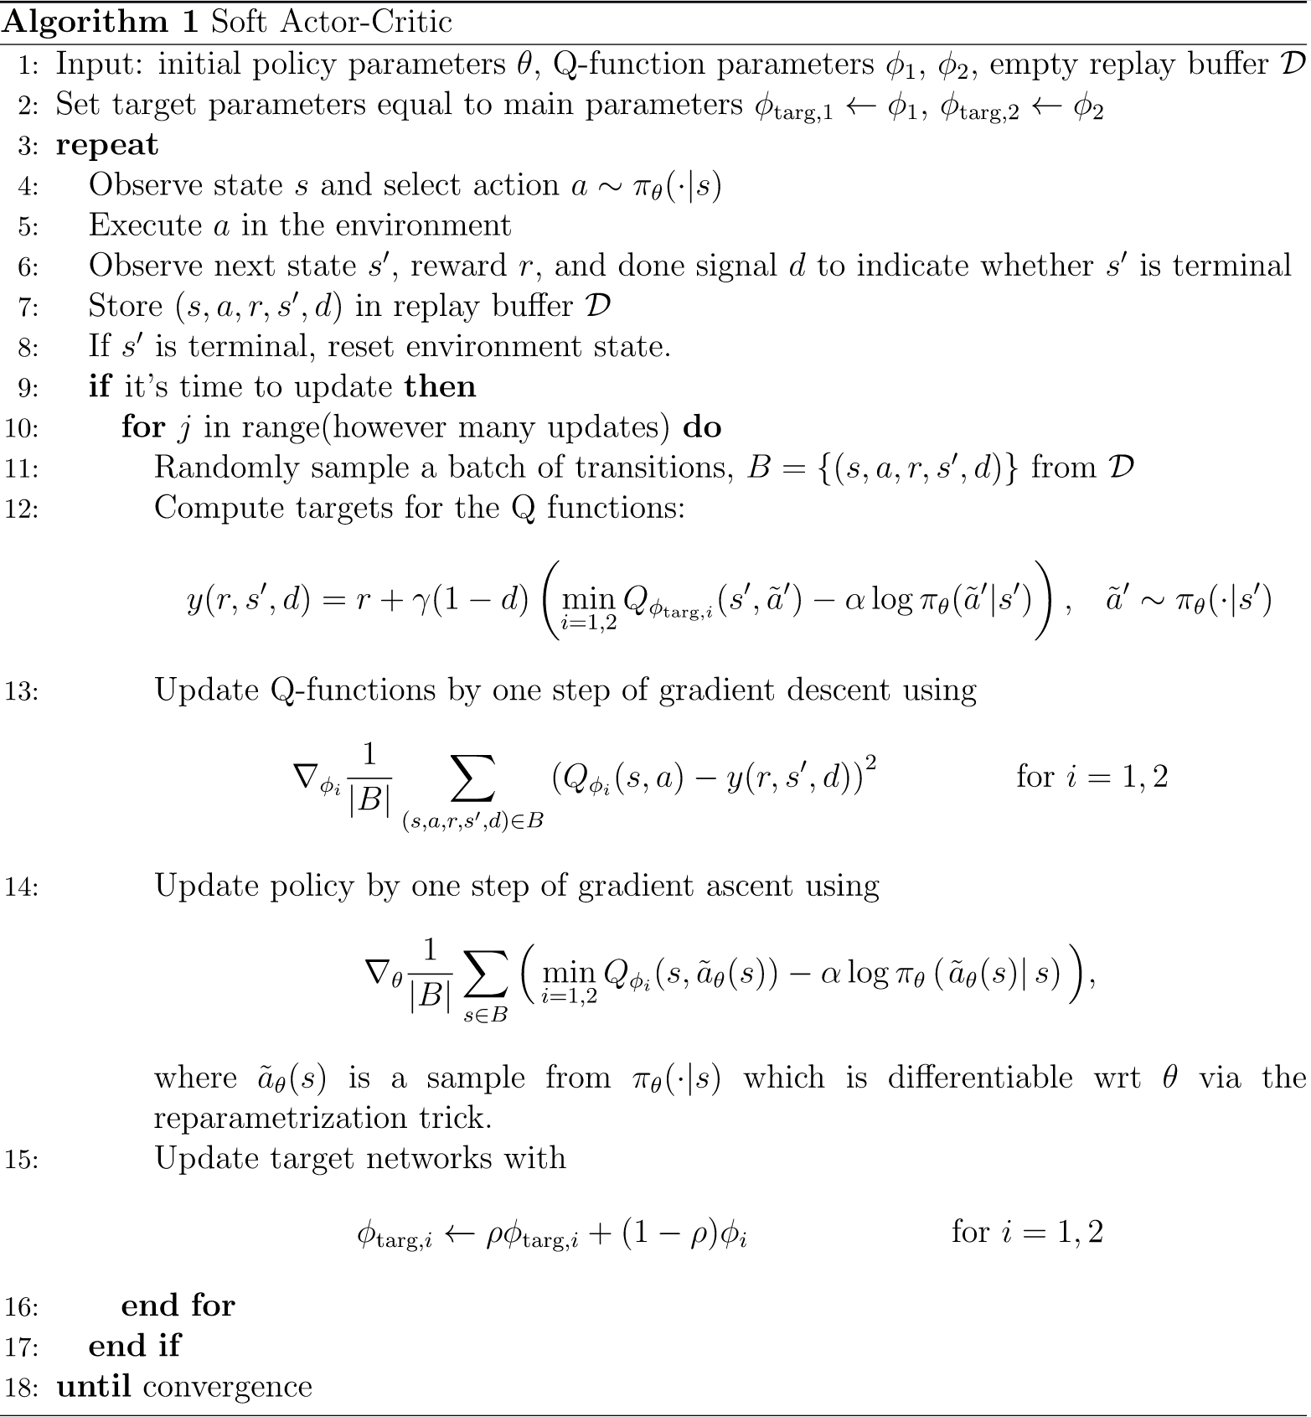
SAC
Q target uses double-Q trick
Q target has policy entropy bonus
a’ ~ the softmax policy
SGD for both Q update
Maximize future rewards sum (Q)
Maximize entropy of policy distribution
SGA for policy update

Slide 32
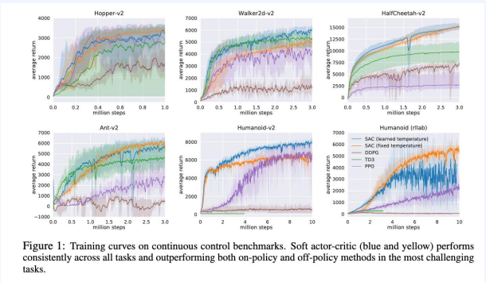
Experiments

Slide 33
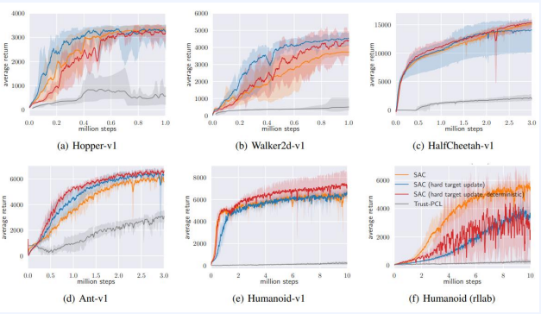
Experiments

Slide 34
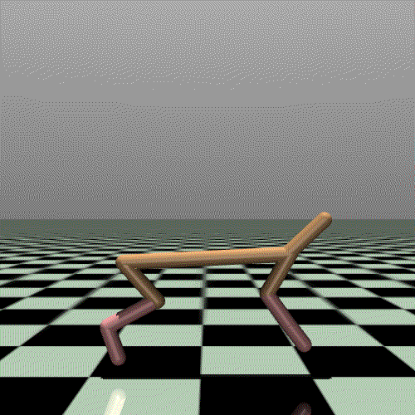
Code Ex.2
Upload ‘soft_actor_critic.ipynb’ file onto Colab
The notebook includes ‘Mujoco’ environment, ‘Half Cheetah’
State(17):
(body parts) position,
(roter, axis) angle or velocity
Action(6):
Torque on 6 roters (-1~1)
Reward:
Forward_reward: moving-forward reward
ctrl_cost: penalty in taking too large action

